Slide 1
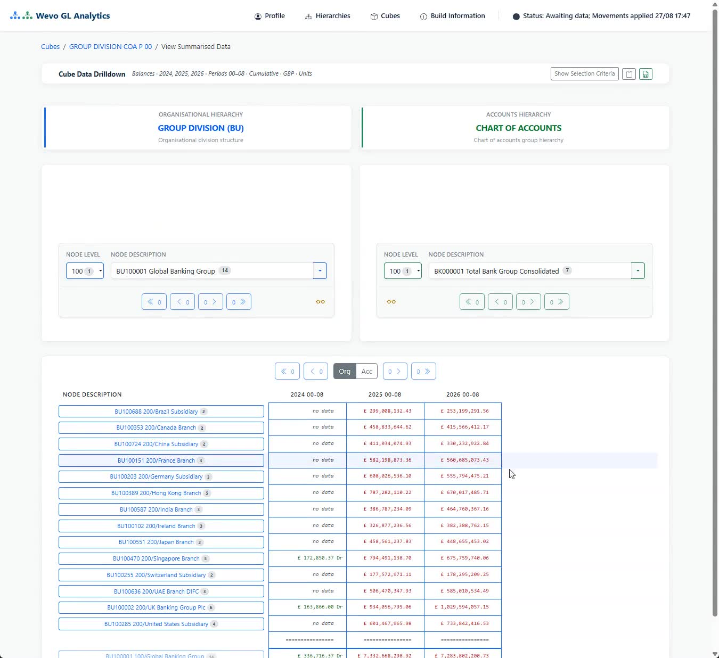
WEVO GL ANALYTICS
MANAGEMENT REPORTING OVER YOUR GENERAL LEDGER
See where every number in your business comes from.
Organise your figures the way you actually run the business, and let anyone who owns a number click straight through to what sits behind it. Minutes behind your ledger, not a night.
Professional Software Ltd | wevo.co.uk

Slide 2
WEVO AT A GLANCE
A reporting layer your existing systems were never designed to be
< 1s
0
4M
1
From any figure to the detail behind it
Overnight batches to wait for. Minutes behind the ledger
Summarised rows calculated and updated every minute
Ordinary server runs the whole thing, inside your estate
WHAT IT REPLACES
HOW IT CONNECTS
WHO CAN USE IT
Nothing. Your GL, consolidation, EPM and BI tools stay exactly where they are.
CSV extracts on your schedule. No live connection to your GL and no access to its database.
Unlimited users and report recipients, at no extra cost.
WEVO GL Analytics
02

Slide 3
THE COST OF THE CURRENT WAY
Same question. Two very different mornings.
A financial controller spots a £241k overspend on materials and needs to know why before the board pack goes out.
REPORTING A NIGHT BEHIND
5 hours
WITH WEVO, MINUTES BEHIND
16 minutes
08:35
Spots the overspend
08:32
Spots the overspend and clicks the figure
No transaction detail in the reporting tool.
The materials breakdown loads in a third of a second.
08:40
Asks the GL team for an export
08:34
Finds what drove it
Ticket raised. Two to four hours, they think.
A £721k stock write-down, already in the figures.
10:15
A 14,000-row spreadsheet arrives
08:37
Checks the same line across other entities
Filtering by hand to isolate the materials lines.
One click sideways. Pattern confirmed.
11:30
Finds a write-down that missed the batch
08:46
Board commentary written. Moves on.
Requests a re-run. The board pack is still not updated.
No exports, no waiting, nobody in IT involved.
Board pack delayed | two manual exports | one batch re-run
Board pack on time | no exports | no batch runs
WEVO GL Analytics
03

Slide 4




SEE IT WORKING
The actual interface, recorded live
A global banking group, fourteen subsidiaries and branches, three years of balances. Every total already exists before anyone asks for it, so each click simply shows it.
Start at the group total
Click any line to go a level down
Switch between organisation and chart of accounts
Under a second from any figure to the detail
Click the picture to play (78 seconds)
WEVO GL Analytics
04

Slide 5




HOW IT WORKS
A layer over the ledger you already run
Wevo never touches your GL database. Nothing is replaced and nothing is migrated.
01
02
03
04
Your GL exports a file
Wevo loads and checks it
Every total is worked out in advance
Finance clicks straight through
Balances and movements land in a folder as ordinary CSV files, on whatever schedule suits you.
New files are picked up automatically, validated against your structures, and loaded with no downtime.
Only what changed is recalculated, at around 4 million summarised rows a minute. The most-used data is released first.
Move through the structure and click any figure to reach the detail - or have the report emailed.
Works alongside SAP, Oracle, Dynamics, Sage or any standard system that produces structured extracts.
WEVO GL Analytics
05

Slide 6
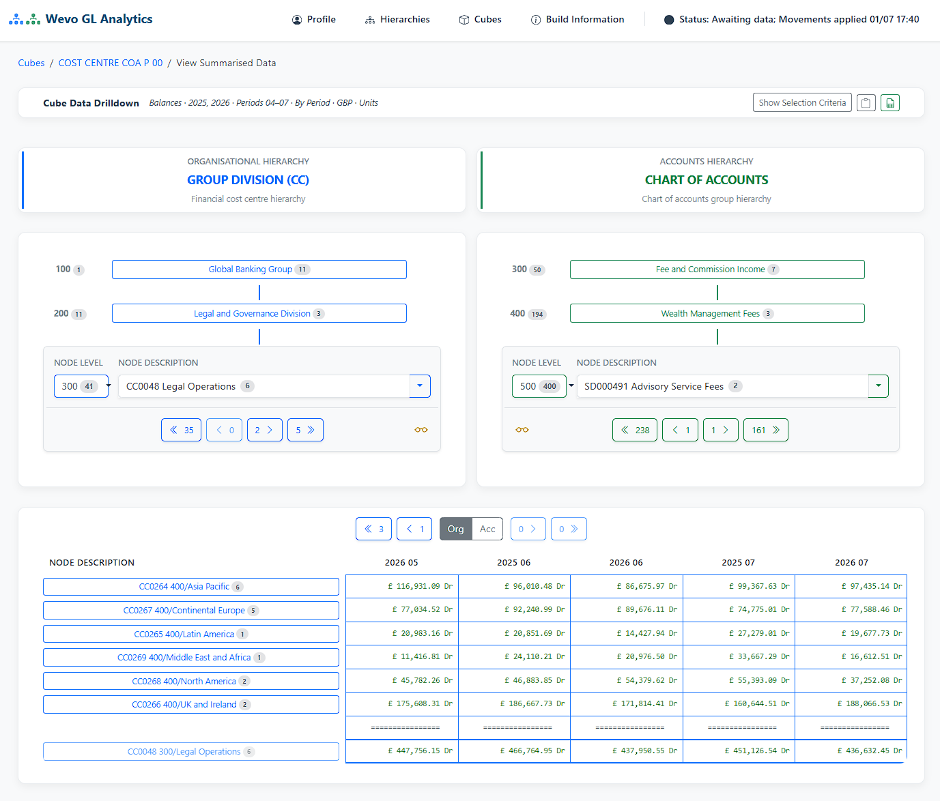
DRILL-DOWN
Two structures, crossed. Click anywhere.
Set your organisation against your chart of accounts and every point where they meet becomes a figure you can read and open.
Budget against actual at every level
Balances, movements or daily movements
Up to 25,000 positions in one structure
Year to date, one period, or between two
Access follows your reporting lines
Export to CSV at any point
WEVO GL Analytics
06

Slide 7
THE IDEA UNDERNEATH EVERYTHING
Your ledger records what happened.
Wevo decides how you read it.
In most reporting tools the structure is baked into the stored figures, so a restructure means restating, remapping or losing the old view. In Wevo the structure is a lens over the ledger. The same postings can be read through today's structure, or the one you reported under three reorganisations ago.
WEVO GL Analytics
07

Slide 8



REORGANISATION-PROOF REPORTING
Your business changes. Your history should not.
A REORGANISATION, IN JANUARY
Read history as it is now
Prior years through today's structure, for a true like-for-like comparison. Automatic, no mapping, no restatement.
LAST YEAR
THIS YEAR
Europe
Germany
France
Spain
Continental Europe
Germany & Austria
France
Iberia
Or as it was then
Prior years through the structure in force at the time, exactly as originally reported. The answer an auditor needs.
In March the board asks what Continental Europe delivered last year. In most systems that is a mapping exercise or a restatement.
Preserve before a change
In Wevo it is a setting.
One click takes a permanent, locked copy of your structures as they stand today.
Management-reporting restatement, not statutory IFRS restatement.
WEVO GL Analytics
08

Slide 9
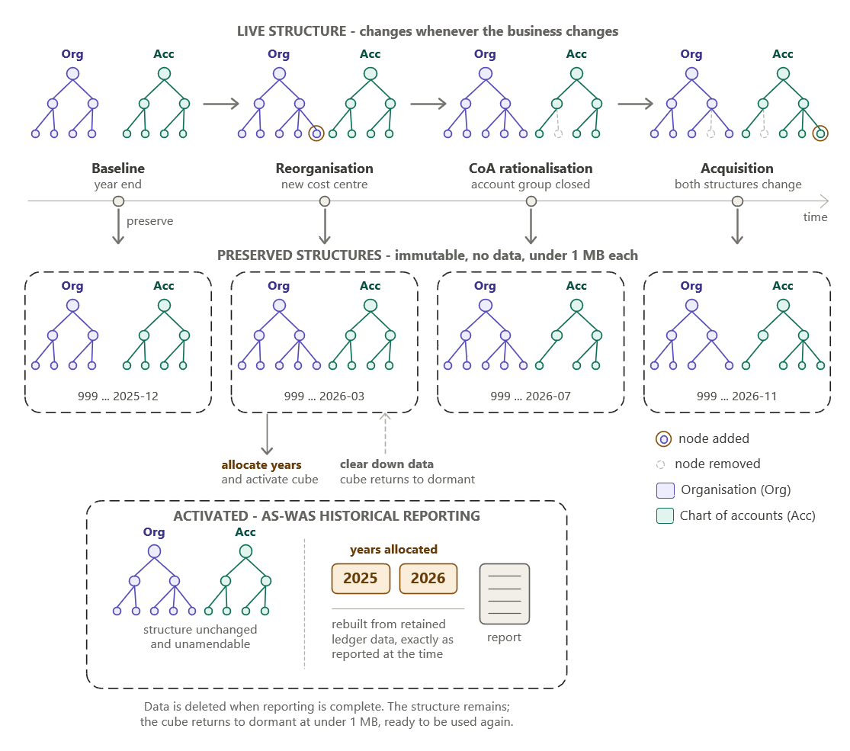
PRESERVE STRUCTURE
Save the exact structure in force today, in one click
< 1 MB
of storage, even for an enterprise group
0
data held and no processing load while dormant
Locked
cannot be amended after creation, only deleted
Months or years later, allocate the years and activate it. The figures rebuild from retained ledger data exactly as they were reported at the time, then clear down again when you are done.
Preserve as often as you like - before a merger, a disposal, a year end. Additional structures are never charged for.
WEVO GL Analytics
09

Slide 10
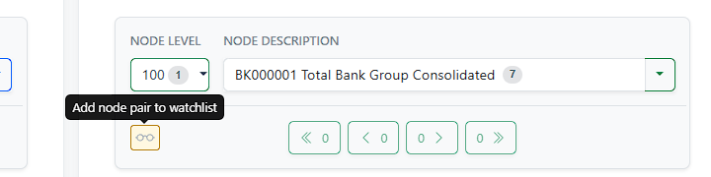
AI-READY DATA
A history of the figures that matter, collected while you work
01
Choose what to watch
An administrator clicks the watchlist icon on any organisation and account pair - a division's revenue, a suspense account, an intercompany balance.
02
Every update captures it
On each update that touches the pair - in practice every 15 to 30 minutes - Wevo writes a time-stamped snapshot of its movements and balances, in every defined currency.
The watchlist button, shown to administrators during ordinary drill-down.
34
values in every snapshot: the opening position and 16 periods, for both movements and balances.
03
It lands in a database table
Ready to query with any tool you already use: your BI platform, your data science team, or an AI service of your choice.
Self-maintaining: entries survive hierarchy rebuilds, and pairs that no longer exist are cleared automatically.
WEVO GL Analytics
10

Slide 11
WHY TIME-STAMPS MATTER
A period total hides the path. The watchlist keeps it.
The ledger tells you where a balance ended the period. It cannot tell you how it got there.
Month-end report: one number, £4.85m
Here a balance sits flat for most of March, builds sharply in the last four days, then reverses as soon as April opens. A month-end report shows only the peak. The watchlist shows the build-up and the reversal, with the time of every step.
That is the kind of pattern an analytics or AI model can flag as worth investigating - automatically, across every watched pair.
Illustrative data
WEVO GL Analytics
11

Slide 12



WHAT A LARGE GROUP CAN DO WITH IT
Wevo collects the data. You choose the questions.
Forecast
Detect
Govern
Rolling forecasts
Unusual postings
Budget overrun warning
Projections that update as each snapshot lands.
Spikes, round sums and late close-period adjustments.
Caught mid-month, not after the close.
Cash and liquidity
Window-dressing
Margin erosion
Short-term position projected from intra-period movement.
Balances that jump before period end and reverse after.
Division by division, as it starts.
Covenant headroom
Seasonality
Suspense build-up
Ratios tracked continuously against limits.
Recurring patterns modelled from a growing history.
Clearing accounts that grow instead of clearing.
Synergy tracking
FX exposure
Intercompany drift
Post-acquisition savings as they land.
Currency balances tracked in every reporting currency.
Balances between entities that stop matching.
Audit sampling
Risk-based selection driven by real behaviour.
Every example runs on the same data: a time-stamped history of the node pairs you choose to watch, in a table you own.
WEVO GL Analytics
12

Slide 13
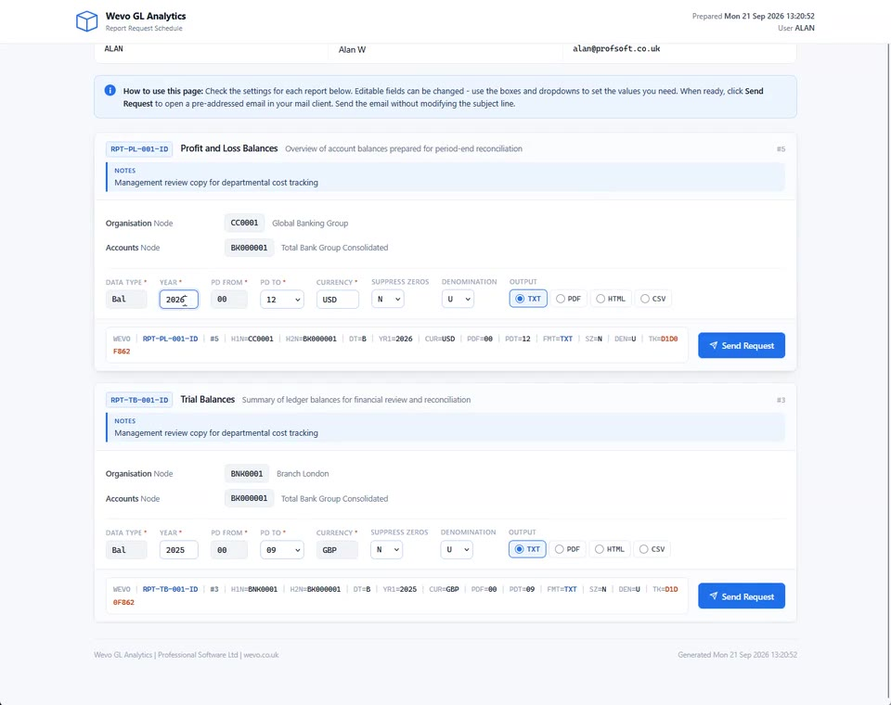
REPORTS BY EMAIL
Their numbers, in their inbox. No login, no seat.
1
A form arrives by email
On your schedule, listing only the reports each person may see.
2
They set what they want
Year, periods, currency and output format, then Send Request.
3
Wevo checks and builds it
Validated against who they are, built from figures minutes old.
4
The report comes back
A reply with the report zipped, normally within a minute or two. TXT, PDF, HTML or CSV, optionally password protected.
A request can narrow what someone sees. It can never widen it.
No limit on recipients, and no seat to buy for any of them.
The request form, recorded live. Click to play (17 seconds).
WEVO GL Analytics
13

Slide 14






DEPLOYMENT AND SECURITY
Your infrastructure. Your choice.
Cloud
Hybrid
MOST COMMON
On-premise
Your own AWS, Azure or Google Cloud account. You control the region and the updates.
Data stays on your infrastructure; the application runs in your cloud account.
The whole stack within your walls. Runs air-gapped if required.
Every capability is present in all three models. No cut-down edition, nothing held back.
Data stays where it is
Your controls, inherited
Everything is logged
No dynamic SQL anywhere
No transfer agreements, no third-party processing.
Azure AD, Okta and your own separation of duties.
Encrypted, time-stamped audit of every change and action.
A whole class of injection risk removed by design.
DESIGNED TO OPERATE WITHIN ENVIRONMENTS GOVERNED BY
GDPR
CCPA
DORA
NIS2
SOX
Basel III
PCI-DSS 4.x
NIST CSF
WEVO GL Analytics
14

Slide 15




THE QUESTION PROCUREMENT WILL ASK
"What happens to us if the supplier does not?"
Most vendors answer it with an escrow clause. Wevo answers it at installation.
The source code is provided
It runs inside your estate
Nothing proprietary underneath
The price is published
Supplied in full at installation under a Continuity Licence. Stronger than escrow, and a ready-made exit strategy.
No licence check, no telemetry, no cloud dependency. Nothing calls out, so nothing stops working.
Open standards, no proprietary runtime and no database vendor tie.
One fixed monthly fee from £5,000, with unlimited users. No per-seat, data-volume or module charges.
Proven ground
An earlier generation of Wevo ran on the mainframe and was bought by two of Scotland's largest banks. It is rebuilt here by its founder, from 25 years in tier-1 banking, financial services and the public sector, as a modern platform that runs on one ordinary server.
WEVO GL Analytics
15

Slide 16


WEVO GL ANALYTICS
NEXT STEP
See it working
on your data.
Half an hour against a real GL dataset - your structure, your numbers, your questions. Or run a ninety-day proof of concept on your own extracts, with the fee credited in full against your first year.
info@wevo.co.uk
wevo.co.uk
Wevo GL Analytics is a product of Professional Software Ltd, registered in England and Wales, company no. 01951252.

